Slide 1
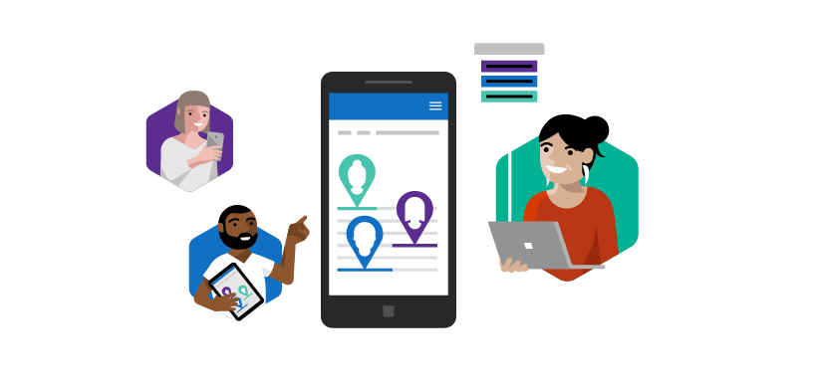
Microsoft Rapid Screening Solution V4 (2.0.0.X) Deployment Guide
April 26, 2021

Slide 2
Disclaimer
This technical deck is solely provided to help deploy the home screening capability of the Rapid Screening Solution. This should be used in conjunction with your organization’s best practices and processes with data privacy, security, and retention policies.

Slide 3
Version 4 (2.0.0.X) – Deployment Steps
1
2
3
4
5
6
Download solution 2.0.0.X from GitHub
Import solution in DEV environment
Add home screening locations
Perform configurations
Correct branding if required
Deploy the solution to the UAT environment
*If moving from an older version (ie. 1.0.0.111) then a data migration needs to be performed for the fields “Age Range” and “Role Type”
7
8
9
10
User testing
Deploy the solution to PROD environment
Migrate the
data to production
(automatically or
manually)
Lessons learned
Perform Configuration in prod

Slide 4
Download solution 2.0.0.X from GitHub

Slide 5
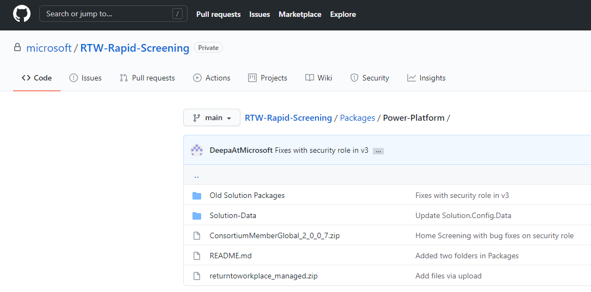
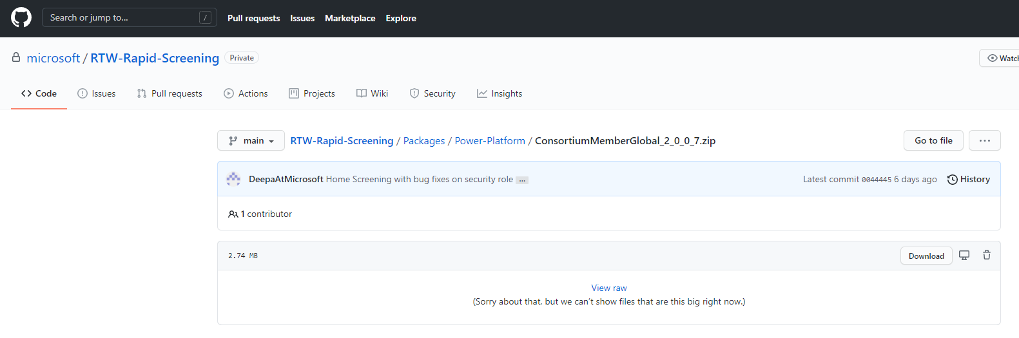
Download solution 2.0.0.X from GitHub
Go to https://github.com/microsoft/RTW-Rapid-Screening/
Navigate to Packages/Power Platform
Click on ConsortiumMemberGlobal_2_0_0_X zip file
Click on “Download”
Locate the {V4 solution} zip file
GitHub note:
If you receive an error 404 it means you don’t have access to the repository and are required to fill in this form to gain access.
Once you have submitted the form and your username has been granted access you will receive an email that will provide you the appropriate link.

Slide 6
Import solution in development environment

Slide 7

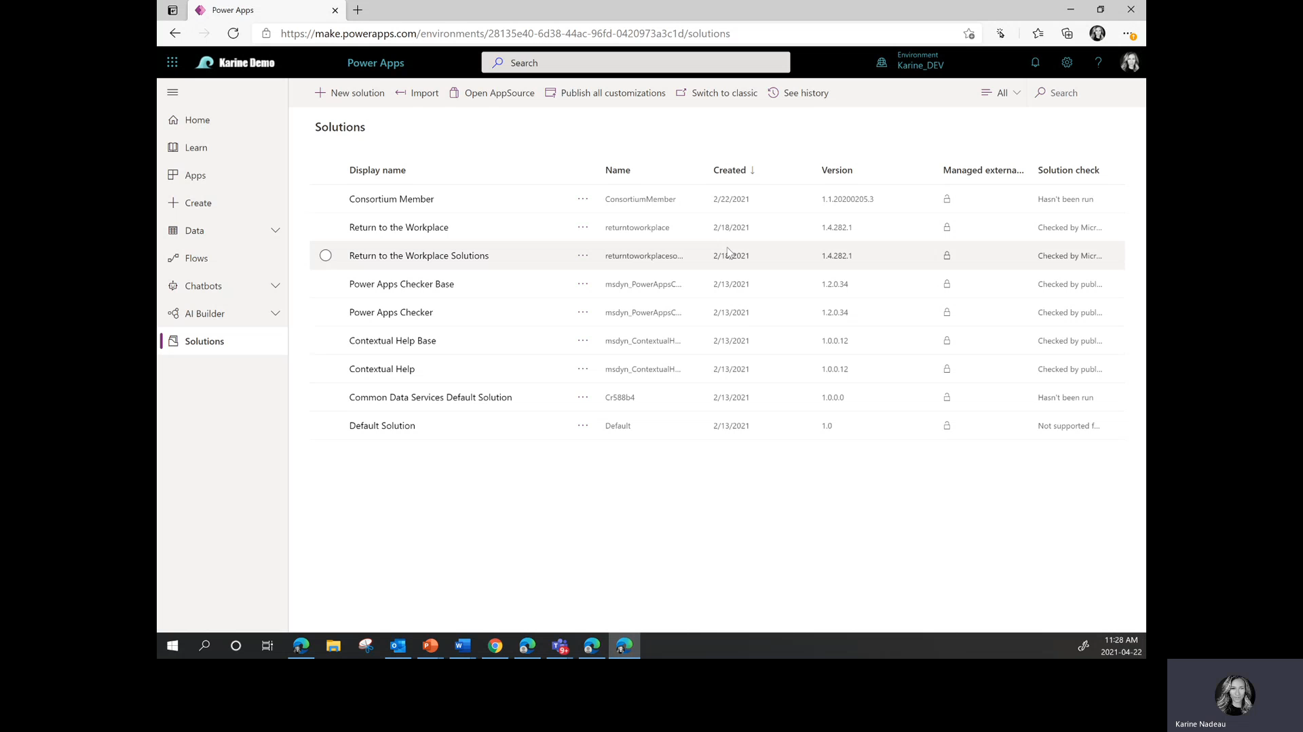
Import solution in DEV environment
Go to make.powerapps.com
Navigate to Solutions
Click on ”Import”
Click on ”Browse”
Locate your {V4 solution} zip file and select it
Click “open”
Click on “next”
Re-establish the connections with the right account
Click on “next”
Enter information for the 2 environment variables (Admin Email Address and Send As Email For Notification Result)
Click on “Import”
Once imported, click on “Publish all customization”
Note: If you are moving from an older version (ie. 1.0.0.111) then a data migration needs to be performed for the fields “Age Range” and “Role Type”

Slide 8
Add home screening locations

Slide 9
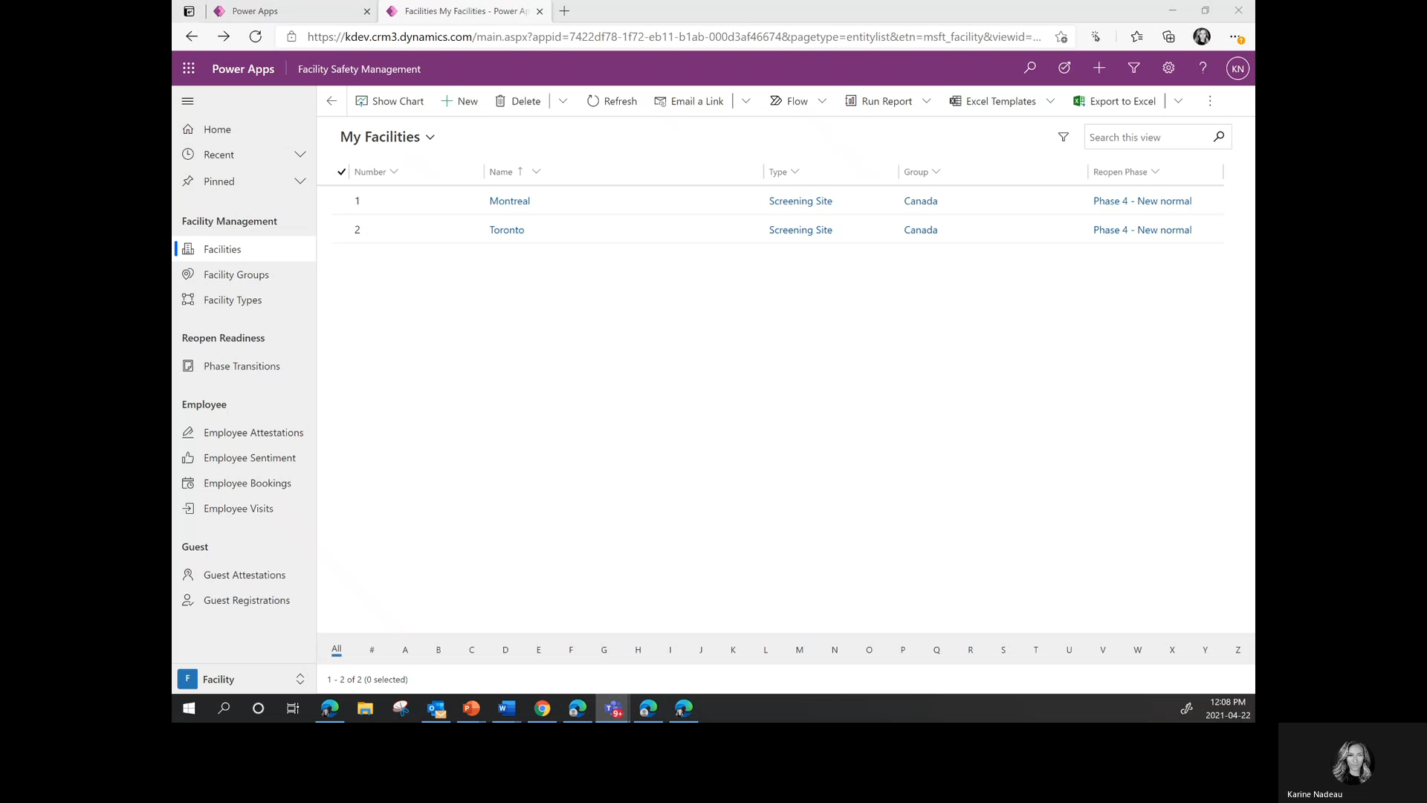
Add home screening locations
Open Facility Management App
Go to Facilities
Click on “New”
Add the follow information
Facility Number: ie.100
Name: ie. Home screening - ONT
Facility Type:
Add new facility type
Type: ie.Home screening
Save
Go back
Repeat C and D for all home screening provinces

Slide 10
Perform configurations
Home screening has 13 configurations.

Slide 11
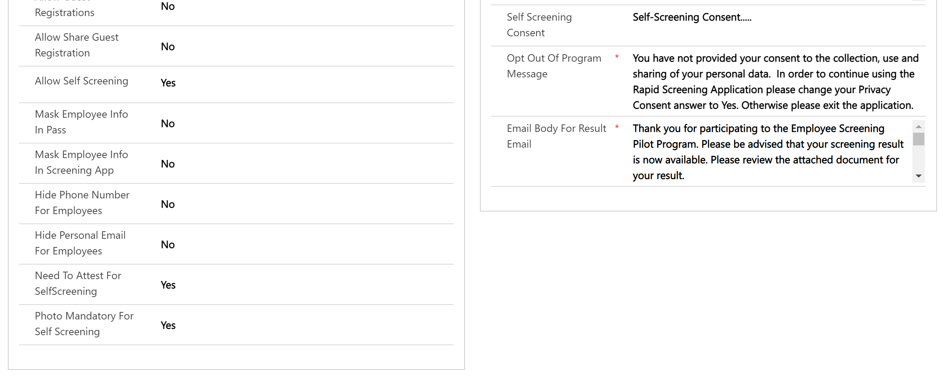
Configuration 1 to 4
Go to Facility Management App/Solution Setup/Solution Settings
Select the Solution Setting
Select a home screening facility
Define
Allow Self Screening
Need To Attest For Self Screening
Photo Mandatory For Self Screening
Self Screening Consent
Repeat for each home screening facilities
Enable or disable home screening features in the solution settings.
4
1
2
3

Slide 12
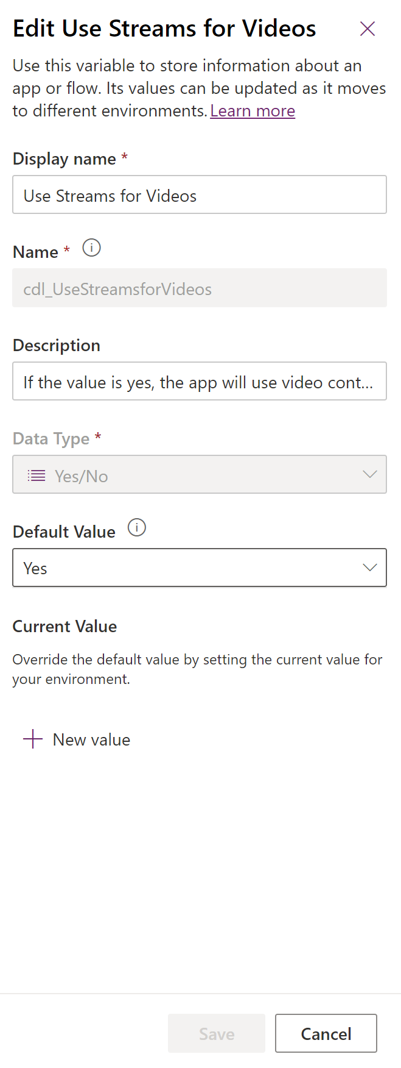
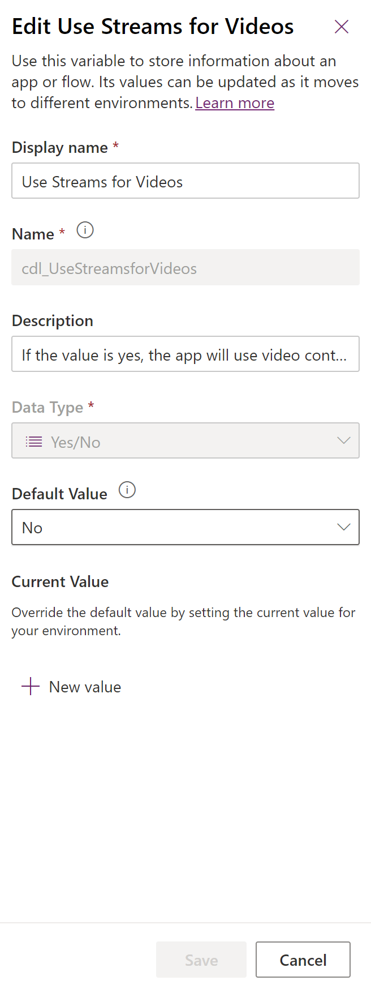
Configuration 5
5A. For Microsoft Streams usage:
Go to Solution/Consortium Member Global/Use Streams for Videos
Set the default value to yes
Input link to videos in configuration 10
5B. For Azure Media Services or YouTube usage:
Go to Solution/Consortium Member Global/Use Streams for Videos
Set the default value to no
Input link to videos in configuration 10
or
Add videos and images to the repository of your choice (Azure Media Services, YouTube or Microsoft Stream).

Slide 13
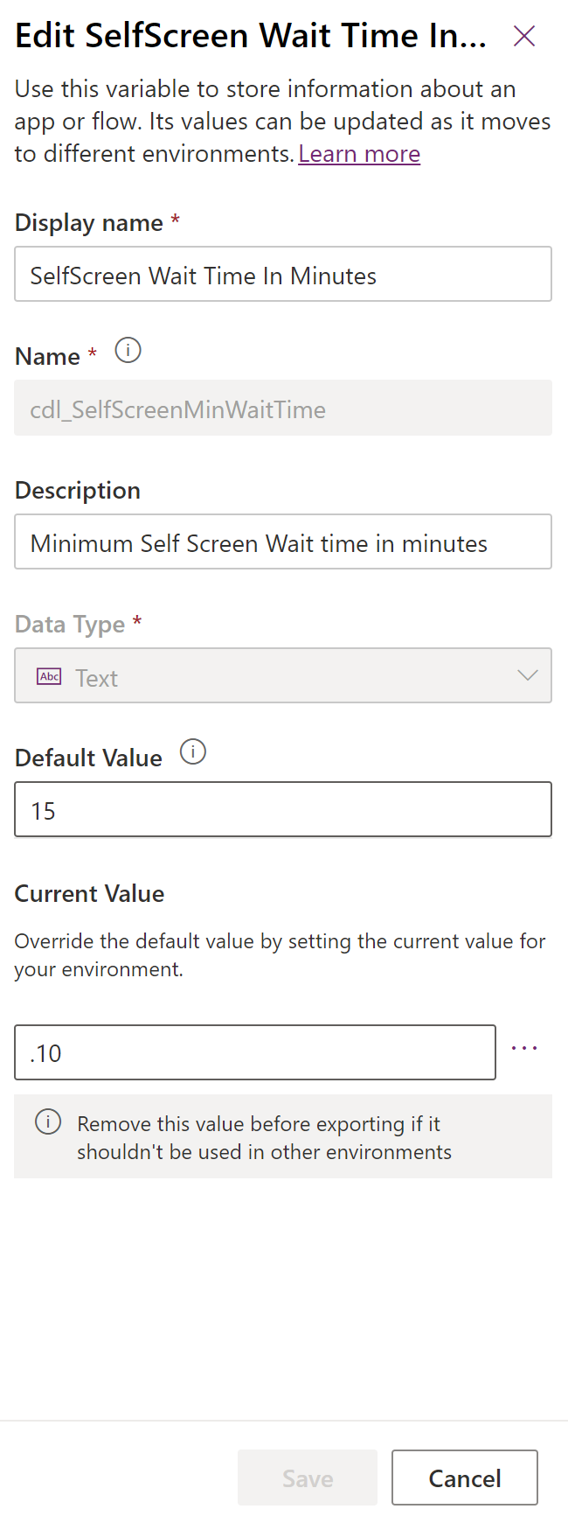
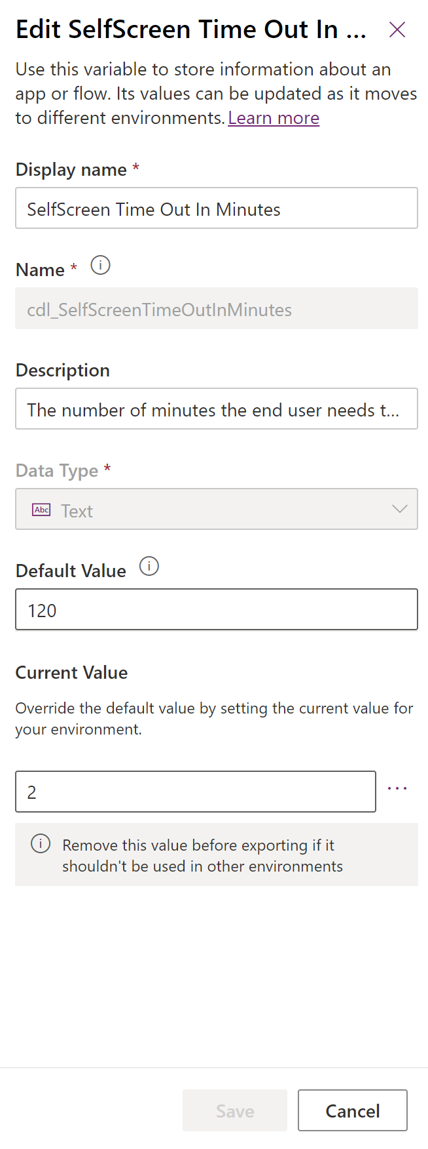
Configuration 6 & 7
6. Minimum Timer
Go to Solution/Consortium Member Global/SelfScreening Wait Time In Minutes
Define minimum time required to input screening result
7. Maximum Timer
Go to Solution/Consortium Member Global/ SelfScreening Time Out In Minutes
Define maximum time allowed to input screening result
and
Define time range to input screening result.
Keep the default value
Or
Add a different value

Slide 14
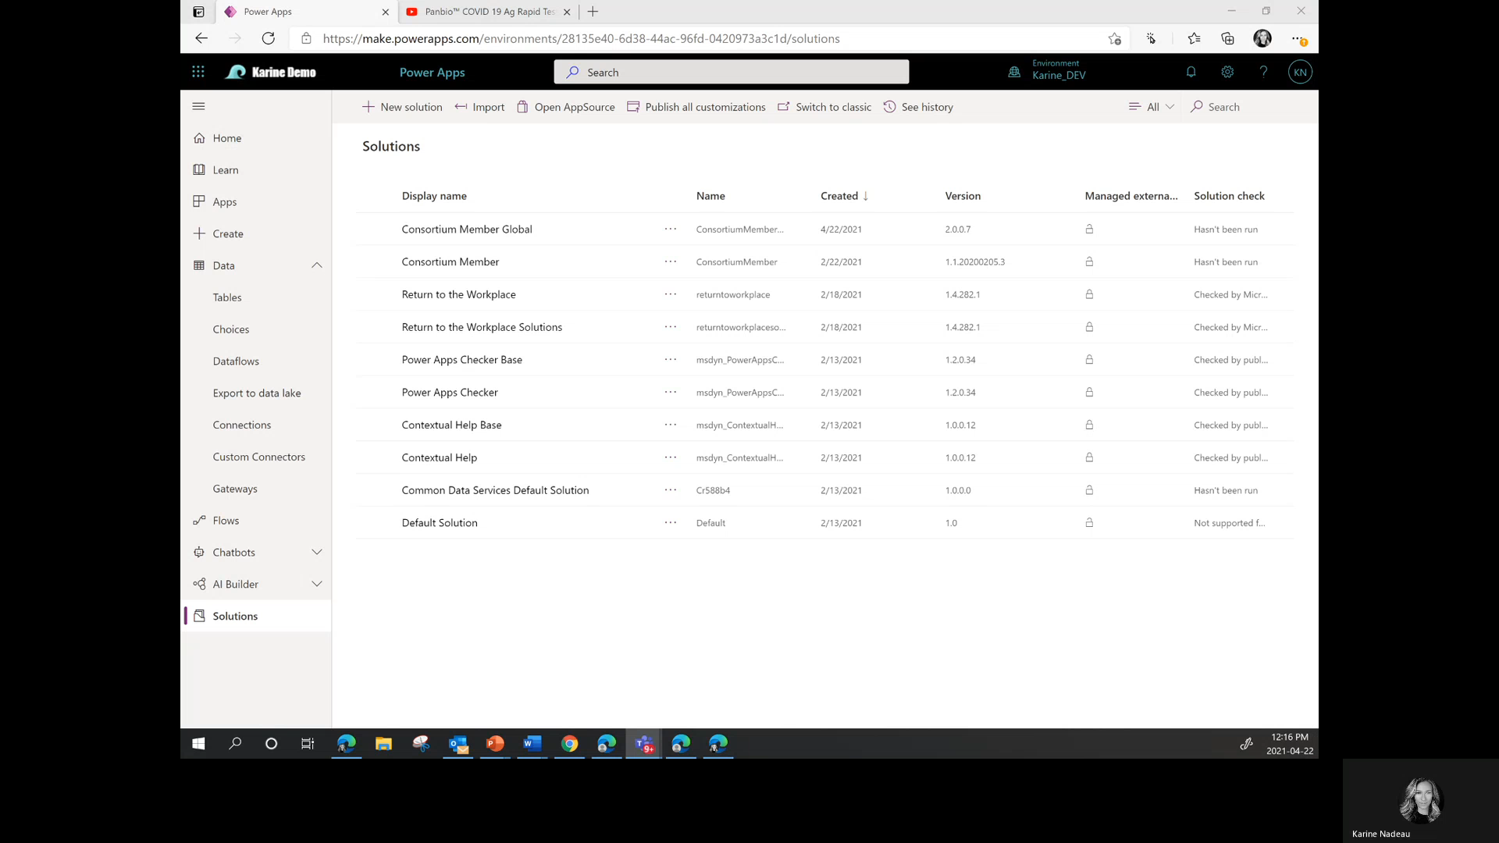
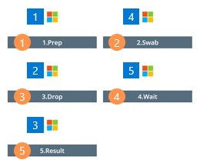
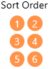
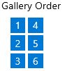
Configuration 8 to 12
Go to Solution/Consortium Member Global/SelfScreening Videos
Select Data
Add new record information
8. Testing Type 9. Sort Order 10. Gallery Order 11. Video link
Click on Save (Once refreshed you will be able to upload the image) 12. Image link
Publish all customizations
Reference for sort and gallery order

Slide 15
Correct branding if required
Adjusting the branding at your own discretion. If you do, we suggest to test and ensure artifacts are in their desired position.

Slide 16
Deploy the solution to UAT environment

Slide 17
Deploy the solution to UAT environment
Export the solution from the development environment
Go to make.powerapps.com
Select your development environment
Navigate to Solutions
Select your {V4 solution}
Click on ”Export”
Click on “Publish”
Click on “Next”
Keep version number as is
Select export as “Unmanaged”
Click on “Export”
Locate the downloaded zip file
Import the solution from the UAT environment
Go to make.powerapps.com
Navigate to Solutions
Click on ”Import”
Click on ”Browse”
Locate your {V4 solution} zip file and select it
Click “open”
Click on “next”
Re-establish the connections with the right account
Click on “next”
Enter information for the 2 environment variables (Admin Email Address and Send As Email For Notification Result)
Click on “Import”
Once imported, click on “Publish all customization”

Slide 18
User testing
Perform all test cases both in a suggested browser and using a supported mobile device (if allowed by your organization) and for all available languages.

Slide 19
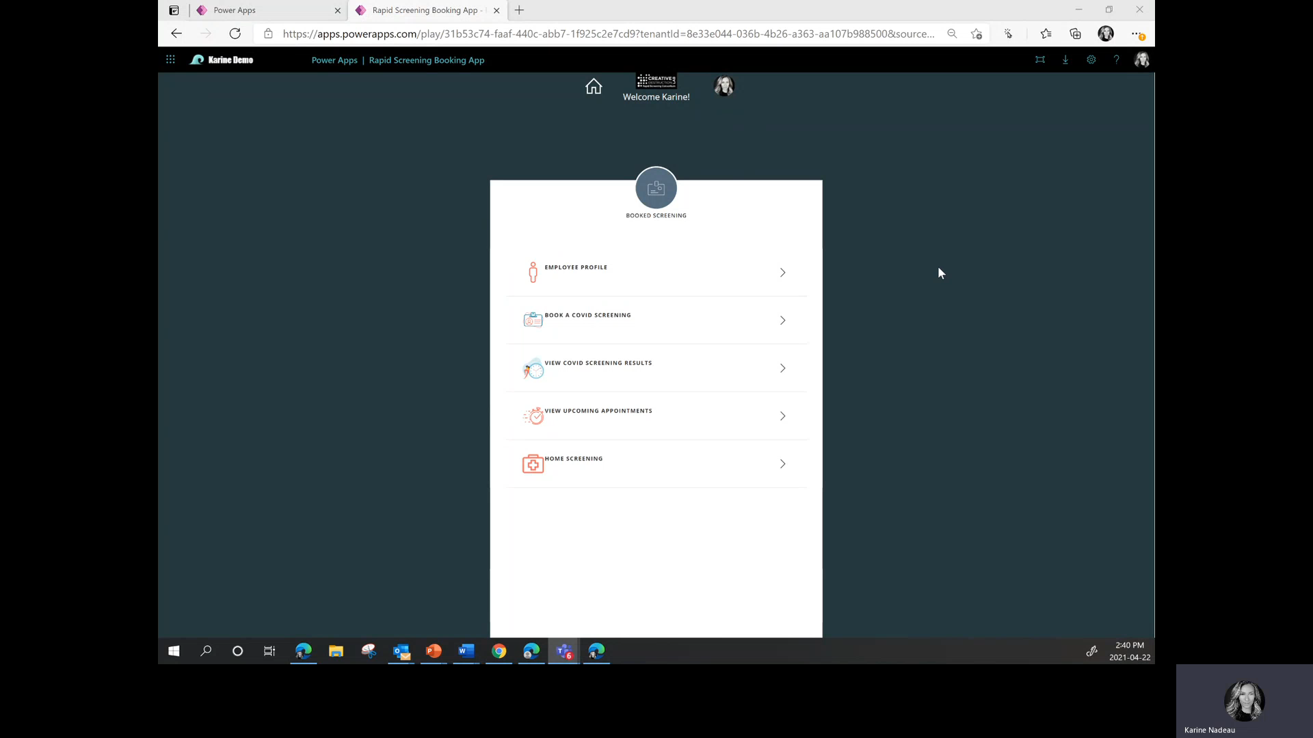
Test Case 1
Checklist:
Employee Profile, defined home screening locations are part of the workplace location drop down
When you try to book a screening there are no timeslots
Exercise:
Employee profile home screening “work location” impact on in-person booking
Steps:
In the Employee App
Click on EMPLOYEE PROFILE
Select a home screening location for workplace location
Click on Confirm
Click on Save
Click on BOOK A COVID SCREENING
Click on the saved home screening location
Repeat:
Test behavior for all home screening locations

Slide 20
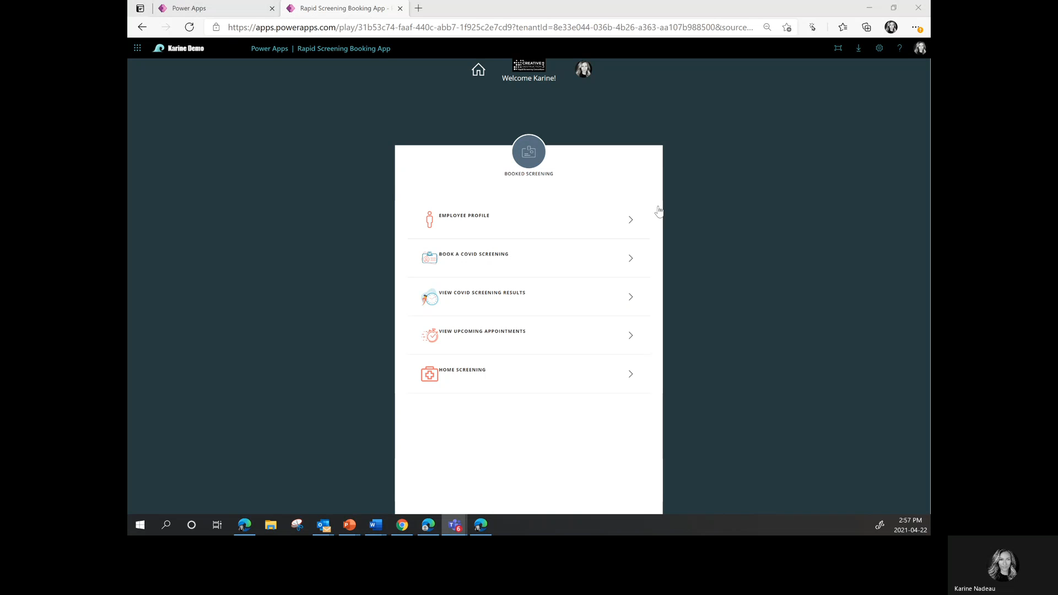
Test Case 2
Checklist:
Employee Profile, when home screening isn’t consented then the consent is triggered when you go to home screening
Employee Profile, when home screening is consented then the test type drop down is shown when you go to home screening
When you don’t consent through home screening then the Employee Profile shows the home screening consent as unchecked
When you consent through home screening then the Employee Profile shows the home screening consent as checked
Exercise:
Disagree/agree to the home screening consent in the Employee Profile.
Steps:
In the Employee App
Click on EMPLOYEE PROFILE
Make sure the home screening consent is unchecked
Click on Confirm
Click on Save
Click on HOME SCREENING
Click on I DISAGREE
Redo step 1 to 5
Click on I AGREE

Slide 21
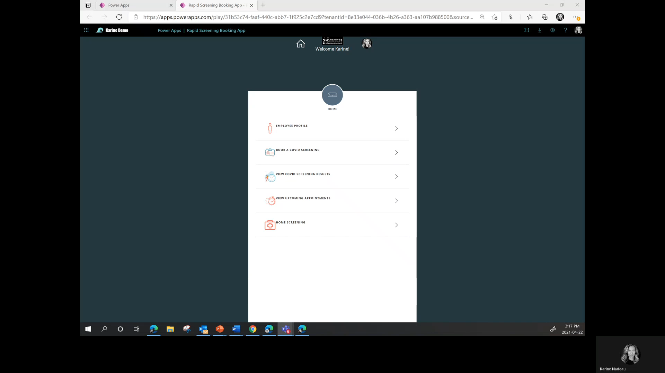
Test Case 3
Checklist:
Test type list, steps titles and images are accurate, and the video navigation works properly
When you disagree to the attestation you get a pop-up then the “Looks like you aren’t feeling well” message and you shouldn’t have any appointments in your booking list
Timer is going down properly
When timer is up, button shows “Time is up”, is greyed out and unclickable
Only when timer is up, the result drop down and “take photo” button are enabled
Clicking or tapping in the middle of the photo control takes a photo and “Retake” button removes previous photo and allow taking a new photo
“Edit” allows you to change your result and photo
The result drop down shows all possible result (ie. negative, presumptive positive, inconclusive)
The last screen shows the proper verbiage to the screening result
Exercise:
Start home screening and disagree/agree to attestation and ensure steps, images and videos are working properly.
Steps:
In the Employee App
Click on HOME SCREENING
Select a test type
Click on step 1 and navigate through videos
Click on Start Screening
Click on I DISAGREE
Click on I DISAGREE
Click on the X
Redo step 1 to 4
Click on I AGREE
Click on Start Timer
Input test result as negative
Click on Take a photo
Click on Retake
Click on Save & go back
Click on Review & Save
Click on Edit
Redo step 14 and 15
Click on Save
Repeat:
Test behavior for all test types.
Test behavior for all test results.

Slide 22
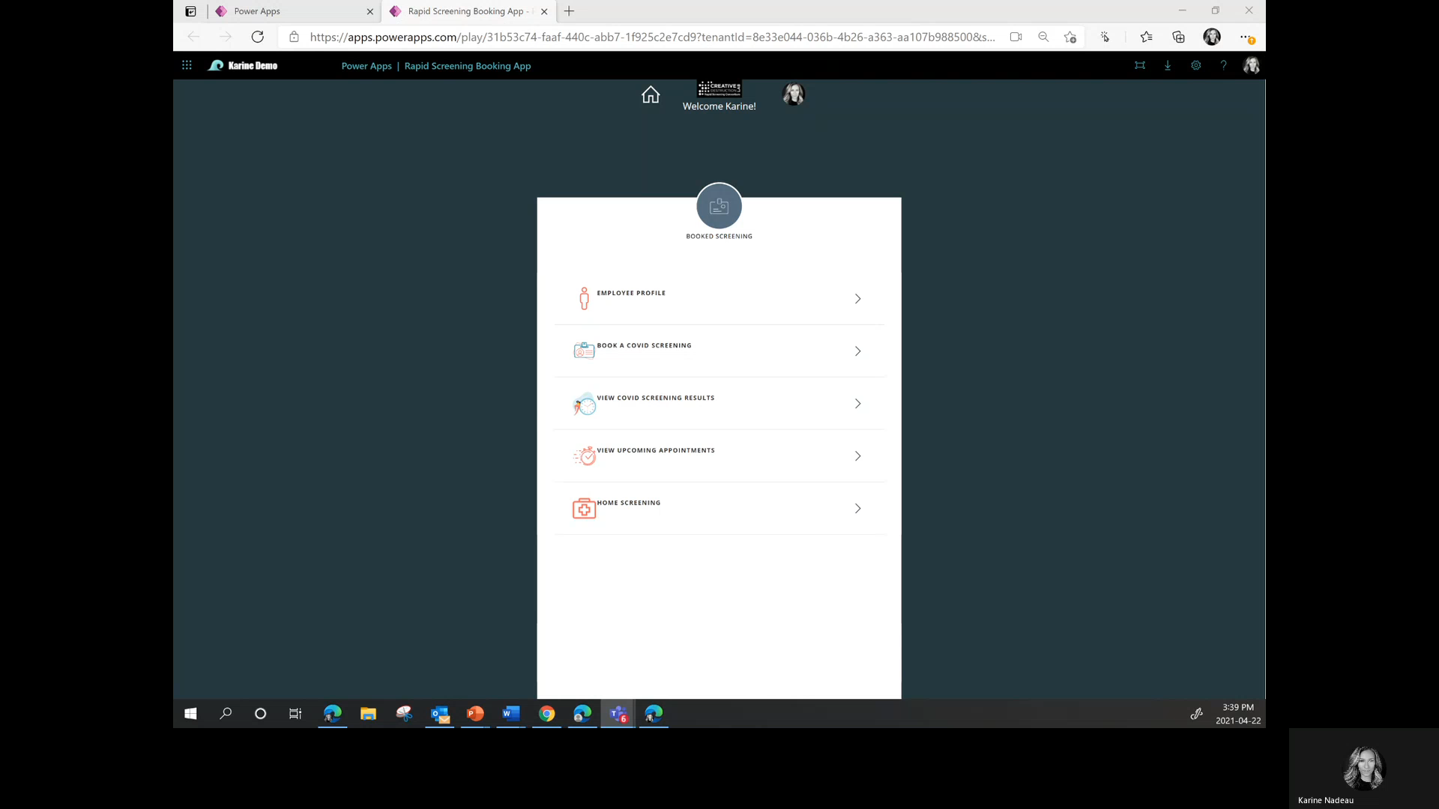
Test Case 4
Checklist:
Timer is going down properly
In VIEW COVID SCREENING RESULTS the Input Result is available
The last screen shows the proper verbiage to the screening result when in and out of time treshold
Exercise:
Test the timer behavior as you get out of the app and come back in and out of the allowed time range (for the demo minimum is 10 seconds and maximum is
30 seconds).
Steps:
In the Employee App
Click on HOME SCREENING
Select a test type
Click on Start Screening
Click on I AGREE
Click on Start Timer
Close the pop-up
Go back home
Click on VIEW COVID SCREENING RESULTS
Click on Input Result
Wait until you are over the time threshold
Select your test result
Take a photo
Click on Review & Save
Click on Save
Redo step 1 to 9
Remind between the time threshold
Select your test result
Take a photo
Click on Review & Save
Click on Save

Slide 23
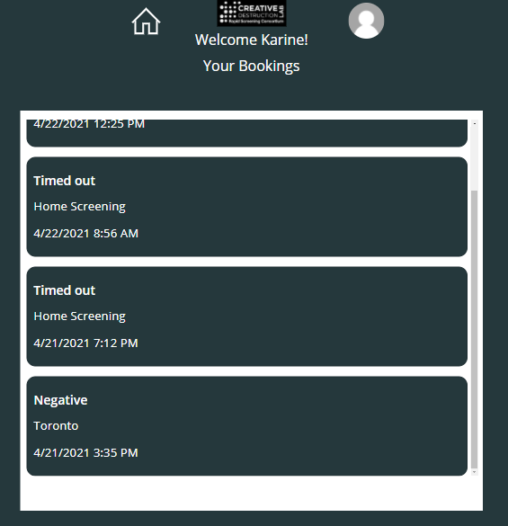
Test Case 5
Checklist:
VIEW COVID SCREENING RESULTS shows the proper location for each bookings
Exercise:
Ensure screenings locations are properly tagged.
Steps:
In the Employee App
Click on VIEW COVID SCREENING RESULTS

Slide 24
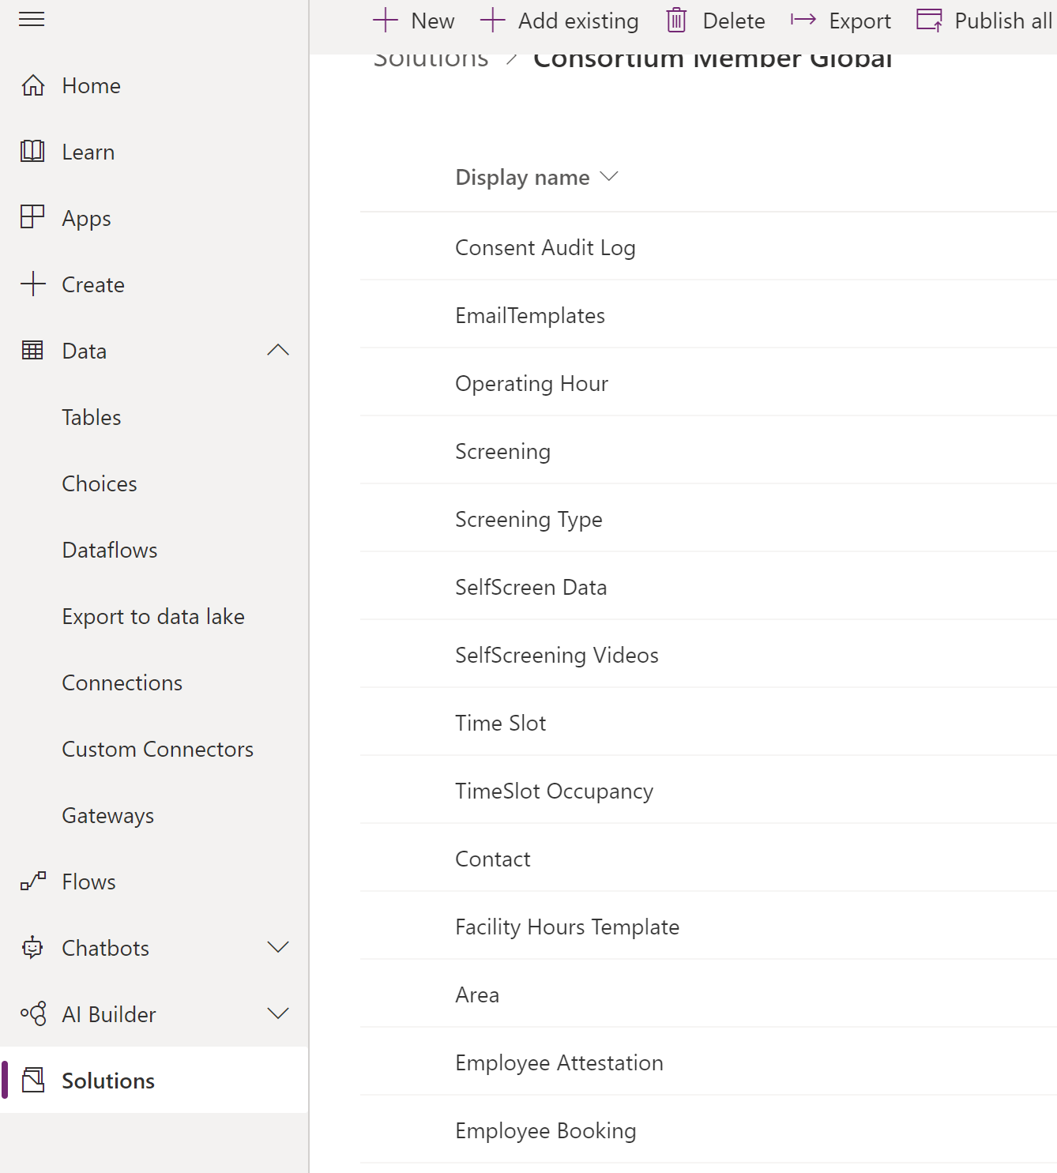
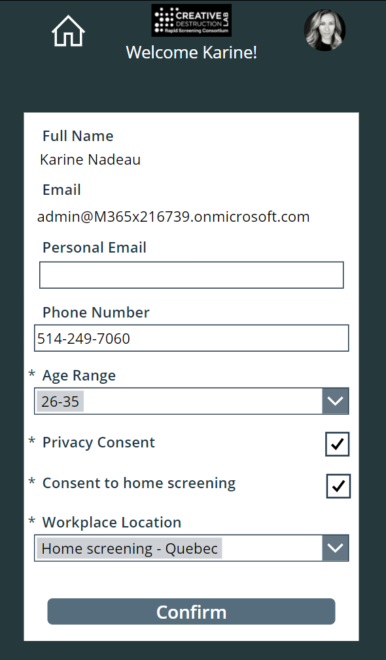
Test Case 6
Checklist:
Screening history is maintained before and after deployment
Booking history is maintained before and after deployment – ie. if there were future bookings, they should still be there post deployment
Employee Profile has the same information before and after deployment – ie. Age range was 26-35 before and is still showing after
Exercise:
Validate the data history.
Dataverse validation steps: In DEV environment
Go to Solutions/Consortium Member Global
Filter by Table
Click on Screening
Click on Data
In UAT environment
4. Go to Solutions/Consortium Member Global
5. Filter by Table
Click on Screening
Click on Data
Compare those two
Do the same for UAT and PROD
Repeat:
Repeat this for the Employee Booking table
Employee profile validation steps:
In DEV environment
10. Open the Employee App
11. Click on EMPLOYEE PROFILE
In UAT environment
12. Open the Employee App
13. Click on EMPLOYEE PROFILE
14. Compare those two profiles (same user)
15. Do the same for UAT and PROD
Repeat:
Repeat this for different users

Slide 25
Deploy the solution to PROD environment

Slide 26
Deploy the solution to PROD environment
Export the solution from the UAT environment
Go to make.powerapps.com
Select your development environment
Navigate to Solutions
Select your {V4 solution}
Click on ”Export”
Click on “Publish”
Click on “Next”
Keep version number as is
Select export as “Unmanaged”
Click on “Export”
Locate the downloaded zip file
Import the solution from the PROD environment
Go to make.powerapps.com
Navigate to Solutions
Click on ”Import”
Click on ”Browse”
Locate your {V4 solution} zip file and select it
Click “open”
Click on “next”
Re-establish the connections with the right account
Click on “next”
Enter information for the 2 environment variables (Admin Email Address and Send As Email For Notification Result)
Click on “Import”

Slide 27
Use data migration tool to input data to production

Slide 28
Use data migration tool to input data to production (automatic method)
Using the data migration tool (automatic method)
Dataverse Web API works with any technology that supports OData and OAuth. There are many options available to move data in and out of Dataverse. OData connector is one of the dataflows, which is designed to support migration and synchronization of large datasets in Dataverse.
Refer to this article for a walkthrough on how to migrate data between Dataverse environments using the dataflows OData connector.
Steps:
Go to GitHub
Go to RTW-Rapid-Screening-main\Packages\Power-Platform\Solution-Data\ConfigurationMigrationTool
Run the DataMigrationUtility.exe
Select “Import data” in Data Migration tool.
Select Office365 on the next screen and then login.
Select the correct environment (development) from the list
Select the zip file named “Solution.Config.Data.zip” from the downloaded GitHub package and then click import data:
Close the application once the import is completed.
For more details, please view section 5.Solution Data Configuration of our full deployment guide on GitHub at: RTW-Rapid-Screening/Documentation/Rapid-Screening-PP-Deployment_Guidev1.1.docx

Slide 29
Use data migration tool to input data to production (manual method)
Using data migration manual method)
Please refer to section “5.Solution Data Configuration” of our full deployment guide on GitHub at: RTW-Rapid-Screening/Documentation/Rapid-Screening-PP-Deployment_Guidev1.1.docx

Slide 30
Lessons learned

Slide 31
Lessons learned
During the push to production ensure users are not booking screenings
Ensure all testing is performed for home screening features before pushing to production
Ensure data history validation is performed
Strongly suggest partner accompaniment
_Guidev1.1.docx

Slide 32
Feedback
We are always looking to improve our documentation. If you have feedback and/or suggestions, please email us at: RapidScreeningSolution@service.microsoft.com

